Slide 1


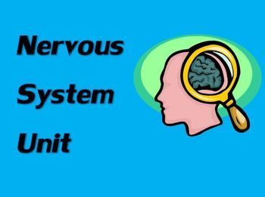
THE NERVOUS AND LOCOMOTOR SYSTEM

Slide 2

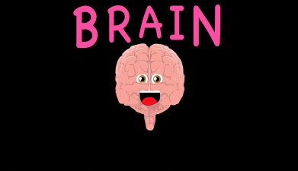
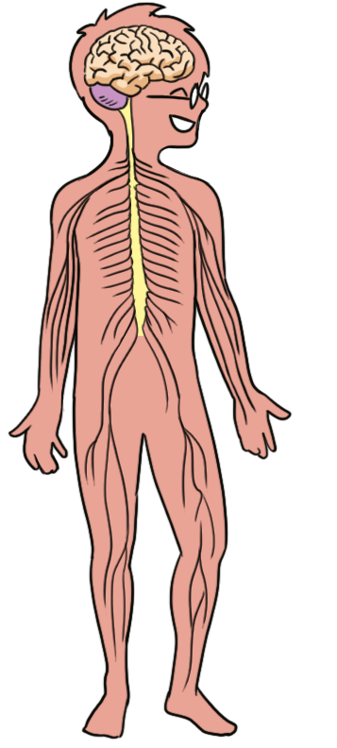
The nervous system
The brain is like the computer of our bodies.
It controls everything that we do.
Sometimes this is involuntary (We don´t think about it)

Slide 3
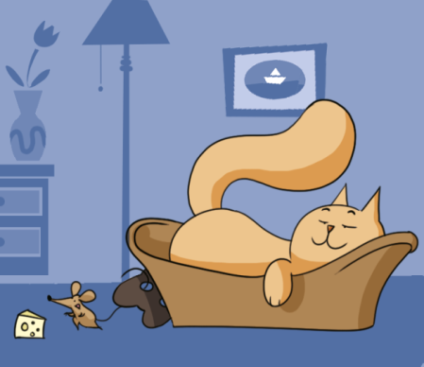
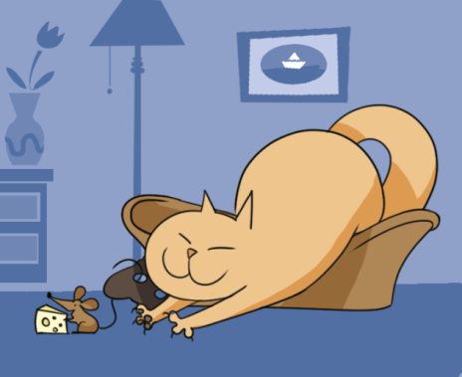
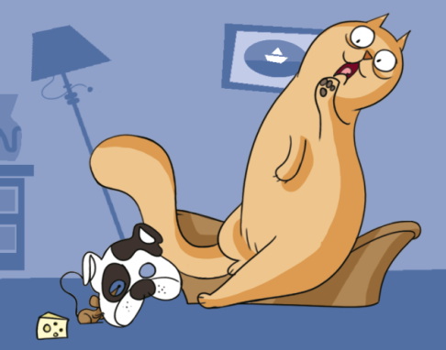
a)message: oh no! A dog! b) instruction: stretch out your paws and catch the mouse! c)instruction: jump back to the bascket d) message : there is a little mouse !

Slide 4
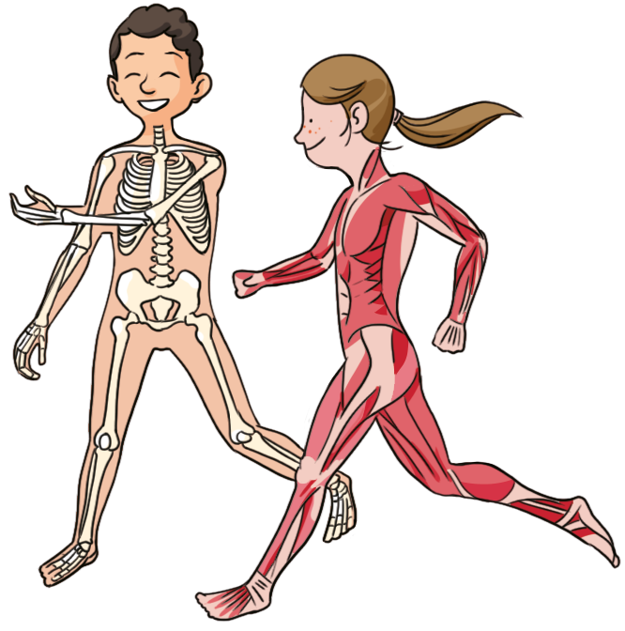
Locomotor system
The locomotor system allows us to move. It is made up of bones, muscles and joints. Bones and muscles work together at the joints to allow our body to bend and move.
When the locomotor system receives an instruction from the brain it goes into action!
The ribs protect the lungs and heart skull protects the brain.

Slide 5

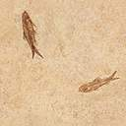



By Lucas ,Berta ,Deividas, Jorge, María and Darío García .
the end

