Slide 2
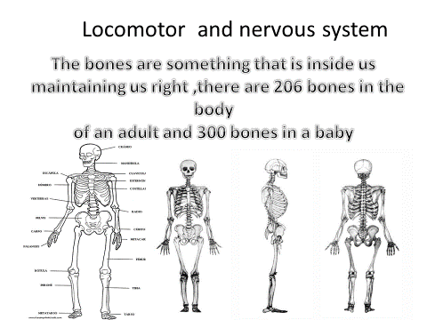

Slide 3
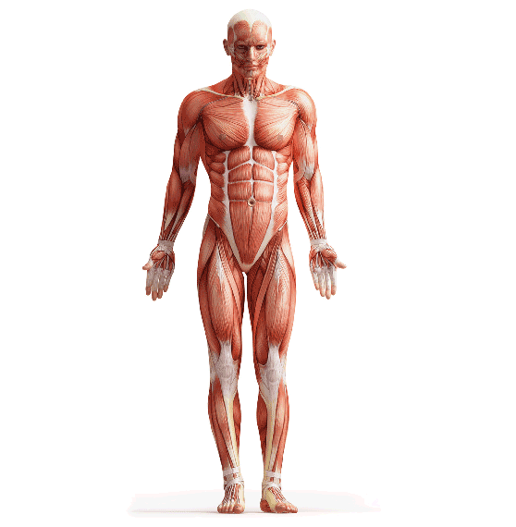
MUSCLES
The locomotor system allows us to move. It is made up of bones, muscles and joints.
Muscles work together with bones at the joints to allow our body to bend and move.

Slide 4
