Slide 1
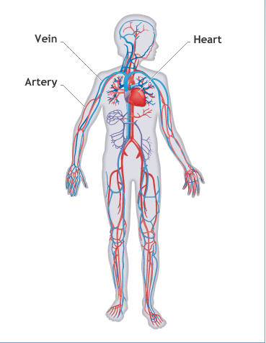
CIRCULATORY SYSTEM

Slide 2
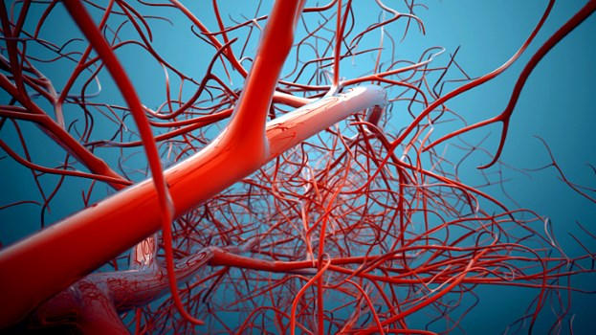
ARTERIES
ARTERIES carry blood from the heart to the rest of our bodies.

Slide 3
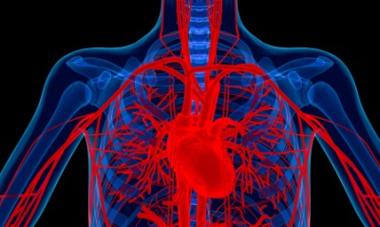
VEINS
Return the blood back to the heart.What do you think the one-way valves are for?

Slide 4
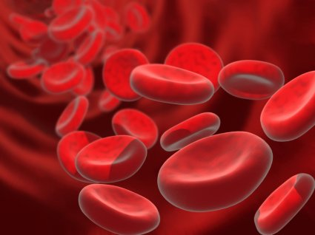
WHAT IS THE BLOOD MADE OF?
The blood is made of a liquid called plasma.The plasma carried: red cells , white cells , platelets and nutrients.

Slide 5
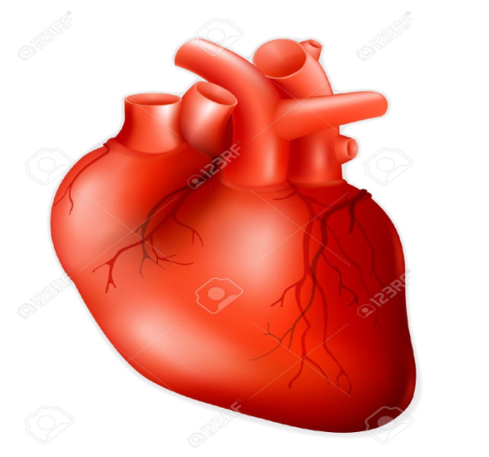
THE HEART
The heart is a hollow muscle.It pumps blood around the body.
Each time it pumps is called a heart-beat .It usually beats 60 to 100 times a minute but it can beat much faster .The more oxygen we need the faster our hearts beat.

Slide 6
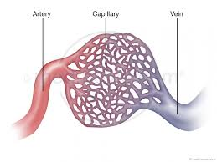
CAPILLARIES
Are tiny blood vessels .They have thin walls.This is where the blood gives nutrients and oxygen to the cells and picks up waste products and carbon dioxide .

Slide 7
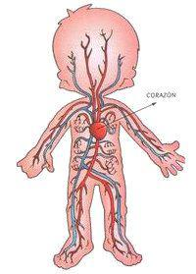
HOW THE CIRCULATORY
SYSTEM WORKS ?
In what order do the blood cells go to : the finger , the lung, the heart? The heart , the lung , the finger.
Eat good and doing sports is good for the heart.

Slide 8
By: ivan,ruben,guille,nico,clara,estrella and celia

