Slide 1
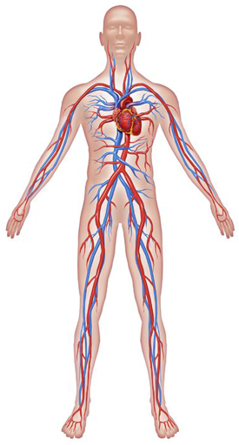
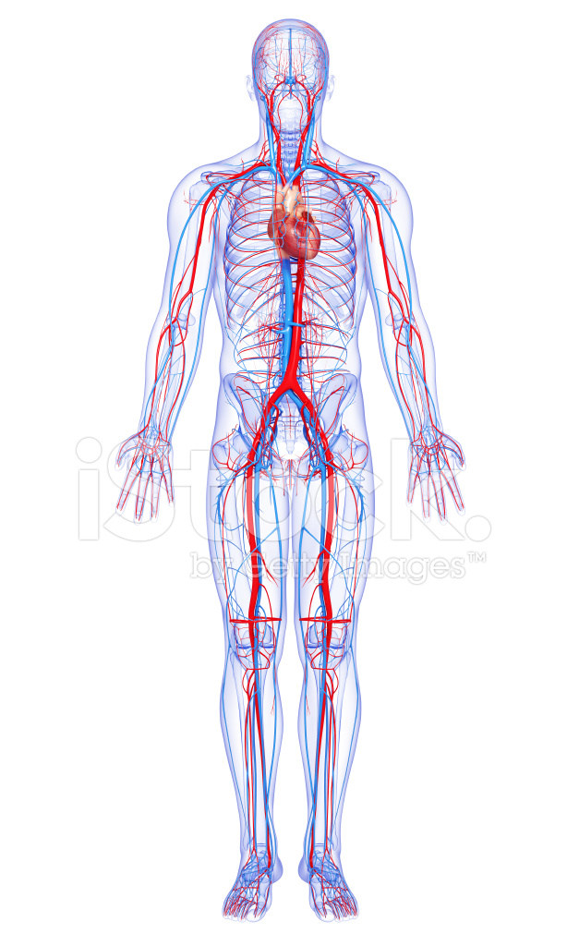
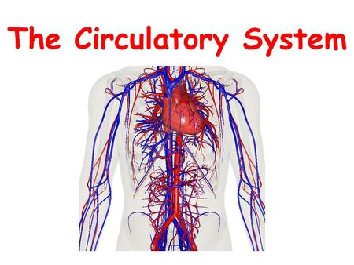
CIRCULATORY
SYSTEM
Created by: Carlos, Clara, Adrian M, Daniel J, Daniel V and Patricia

Slide 2
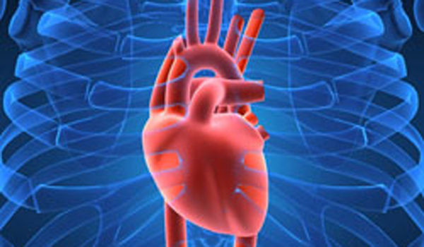
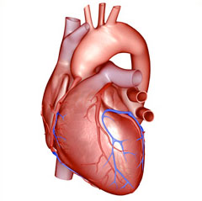
HEART
What is the heart?
The heart it’s the organ that acts like a pump
The heart is a hollow muscle
It pumps blood around the body
Each time it pumps is called a heartbeat.
It usually beats 60 to 100 times a minute but it can beat much faster.

Slide 3
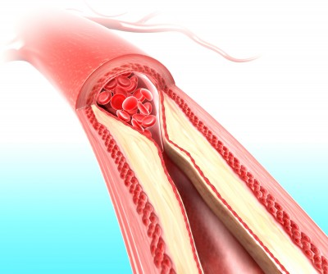
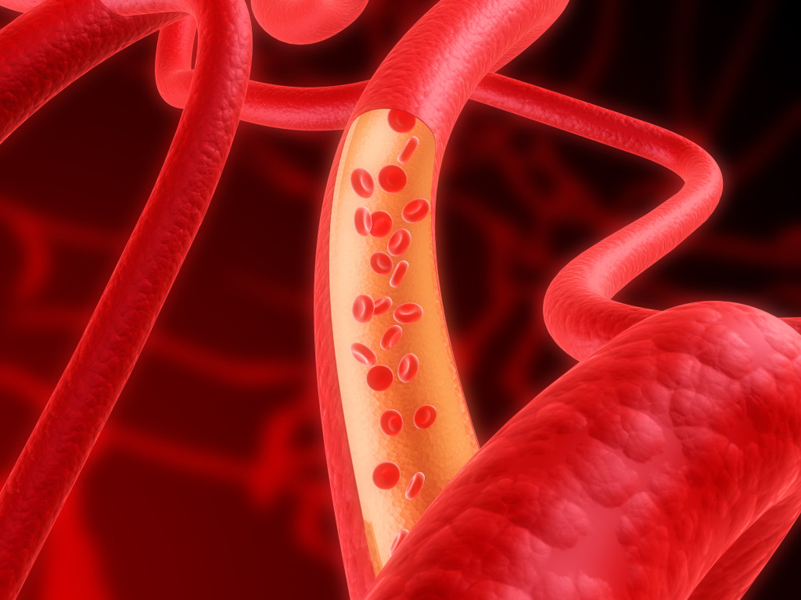
ARTERIES
WHAT ARE THE ARTERIES?
Arteries carry blood from the heart to the rest of our bodies.

Slide 4
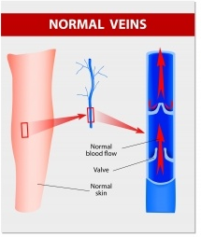
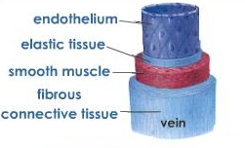
VEINS
WHAT ARE THE VEINS?
Veins return the blood back to heart.

Slide 5
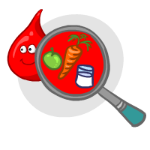
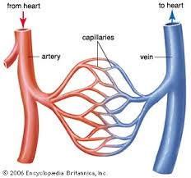
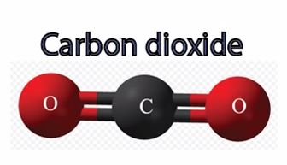

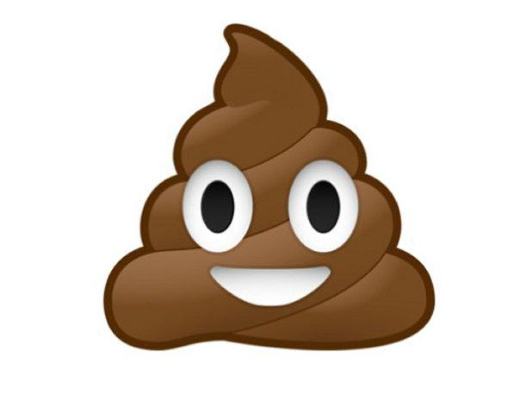
CAPILLARIES
Capillaries are tiny blood vessels with thin walls.
Here blood give food to cells and picks up the waste.
Waste products

Slide 6
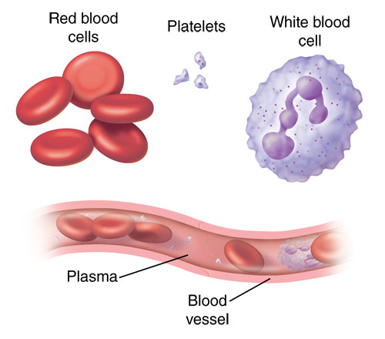
BLOOD
What is blood made of?
Blood is made of Plasma. It carries nutrients and also red cells, white cells and platelets.
Red cells: carry oxygen
White cells: fight infection.
Platelets: help blood to clot and form scabs.

Slide 7


