Slide 1
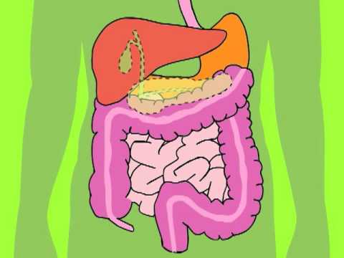
DIGESTIVE SYSTEM

Slide 2
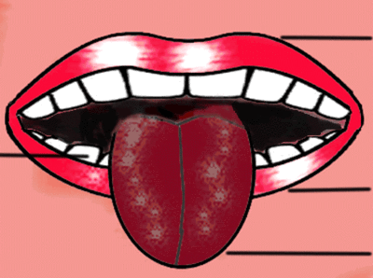
MOUTH
In the mouth food is mixed with saliva and broke by the teeth.

Slide 3
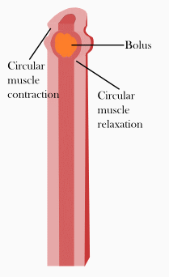
THE ESOPHAGUS
This is the tube were the food goes to the stomach.

Slide 4
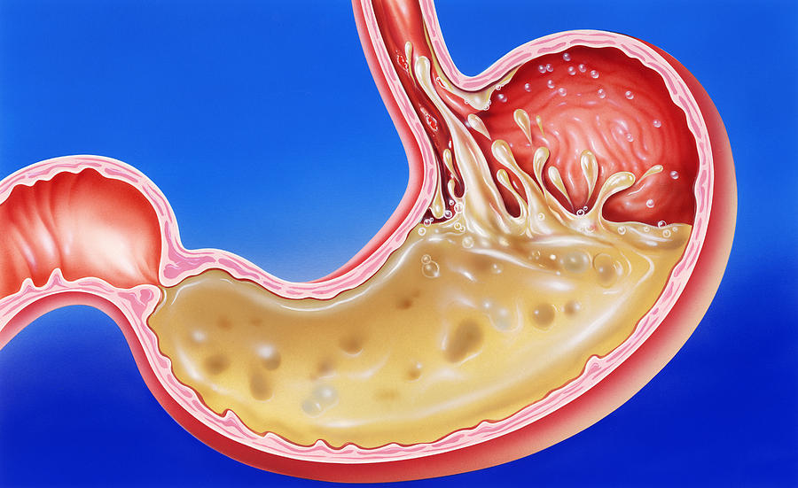
STOMACH
In the stomach gastric juices make food and specie of thick liquid

Slide 5
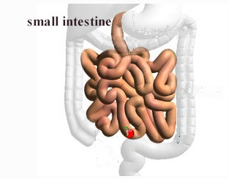
The small intestine
In the small intestine there are a lot off
blood vesels, the nutriens pass in to
the blood here.

Slide 6
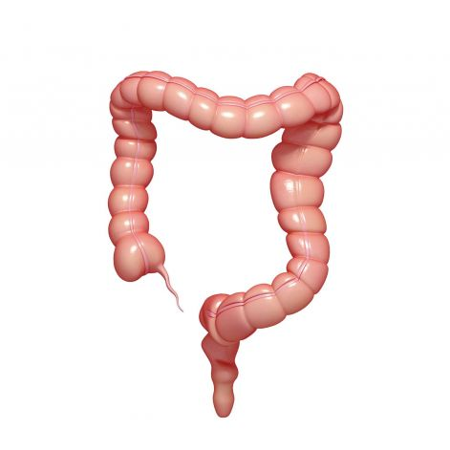
The large intestine
Water goes out in to the body and the waste becomes
harder
The large intestine starts
in the end of the small intestine
and ends in the anus.

Slide 7
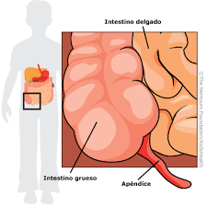
THE ANUS
The waste leaves the body here.

