Slide 1
EXCRETORY SYSTEM
Kidneys
Ureters
Bladder
Urethra

Slide 2

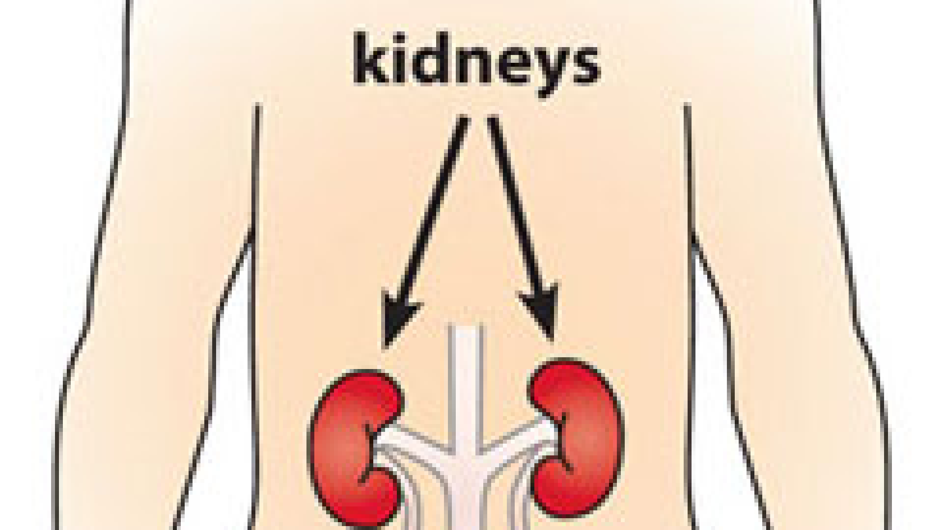
KIDNEYS
First the blood goes to here excess of water and waste dropped off into urine then it goes to the Ureters

Slide 3
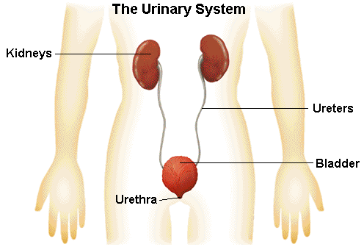
URETERS
The urine goes down to this tube called ureters ,when the urine passes through the ureter goes directly to the bladder and when you go to the bathroom urine passes through the urethra.

Slide 4

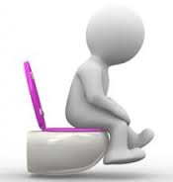
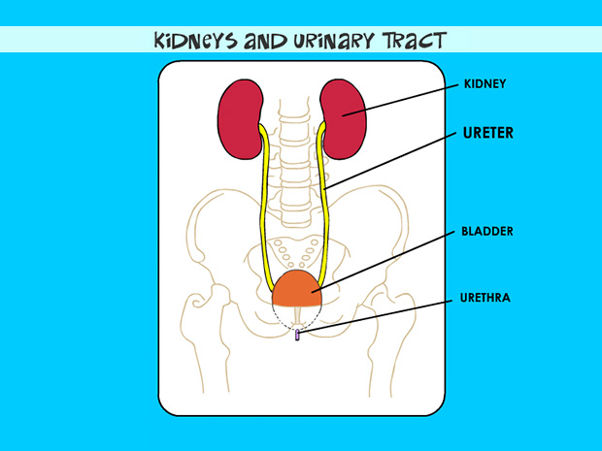
BLADDER
The urine is stored here then wen is full it sends a mesaje to our brain

Slide 5

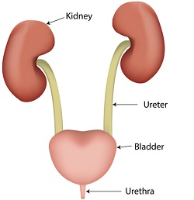
URETHRA
The urine leaves the body through this tube

Slide 6

BY
NEREA,
CARMEN
AND
DYLAN

