Slide 1
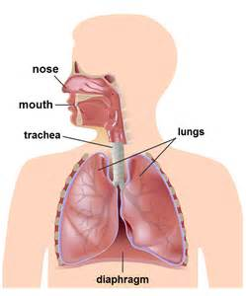
RESPIRATORY SYSTEM

Slide 2
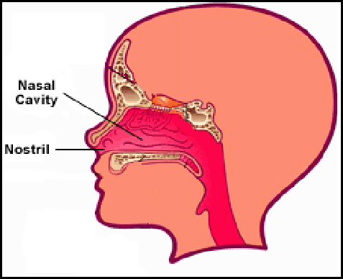
NOSE
We breathe in air through our nose.
The nose has two nostrils.
These have lots of hairs and are narrow
at the back.

Slide 3
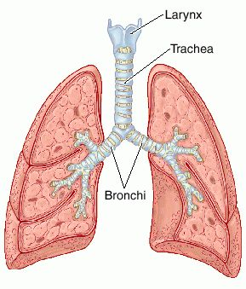
TRACHEA
The trachea divides into two
tubes that go into the lungs.
These are called the bronchi.

Slide 4
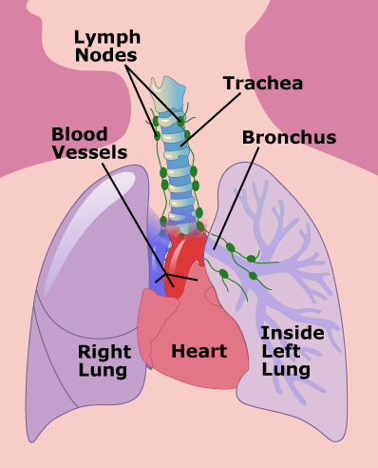
LUNGS
The lungs are like big sacks.
They are made up of lots of little
bags called alveoli surrounded by blood capillaries.

Slide 5
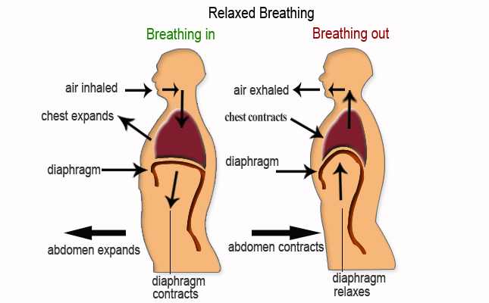
HOW WE BREATHE
We breathe faster when our bodies need more oxigen, for example when we running.

Slide 6
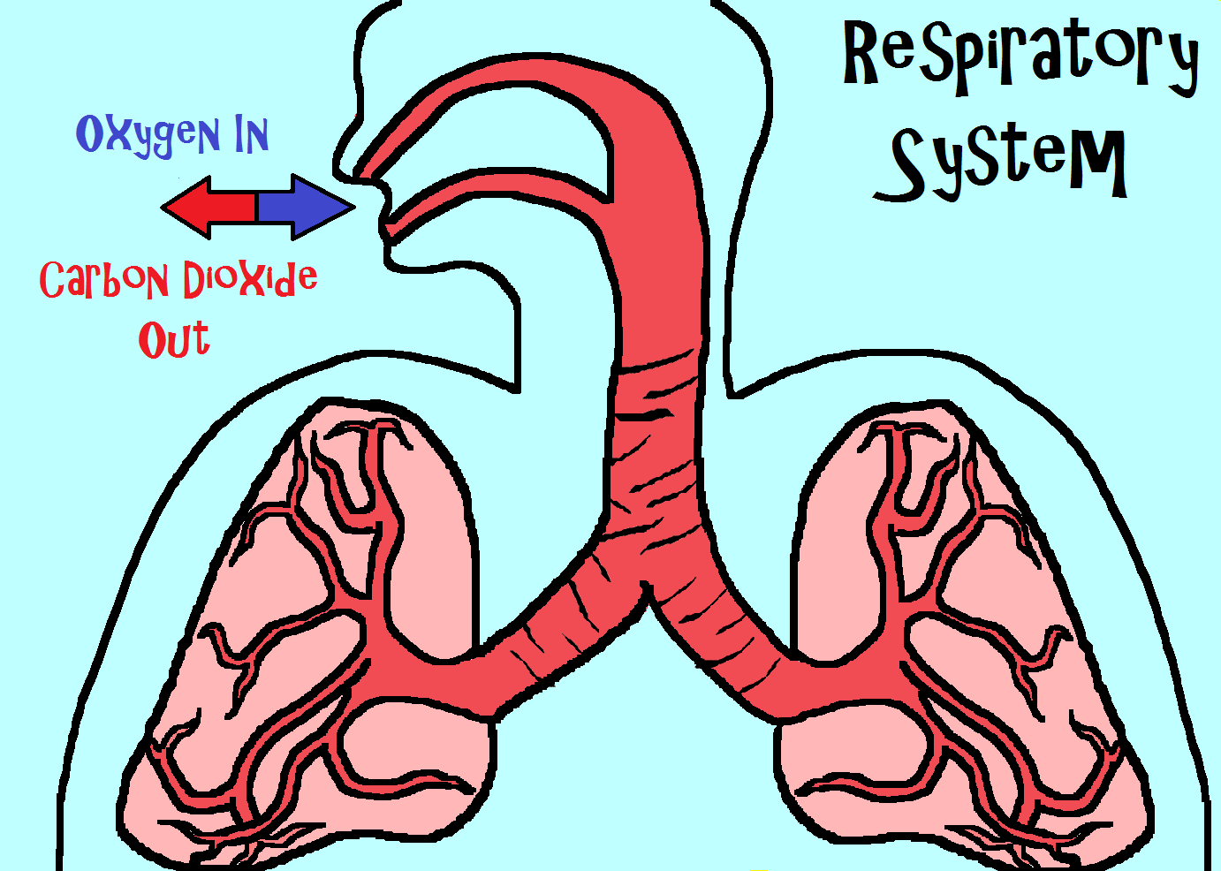
CARBON DIOXIDE AND OXYGEN
We breath in oxygen and we breath out carbon dioxide.

Slide 7
THE END
Did you like it????

