Slide 1

MATTER AND ENERGY
UNIT 5

Slide 2
What is matter?
Matter is anything we can touch, taste or smell.
Everything in our planet and in the Universe is made up of matter.

Slide 3
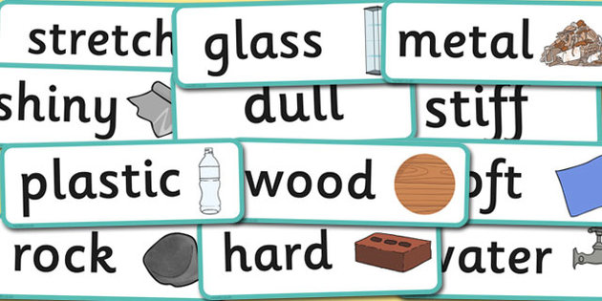
What are materials?
Materials are made up of matter, and we use materials to make things.

Slide 4
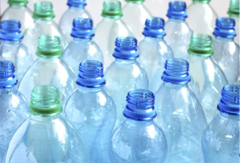
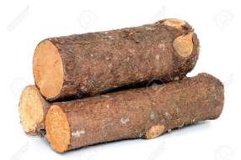
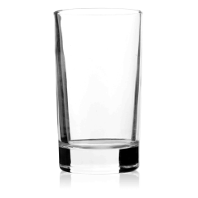

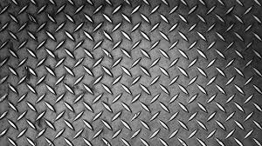
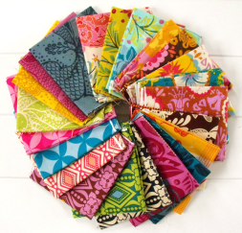
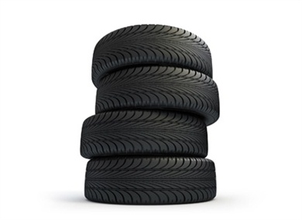
Materials
Plastic
Wood
Glass
Paper
Metal
Fabric
Rubber

Slide 5
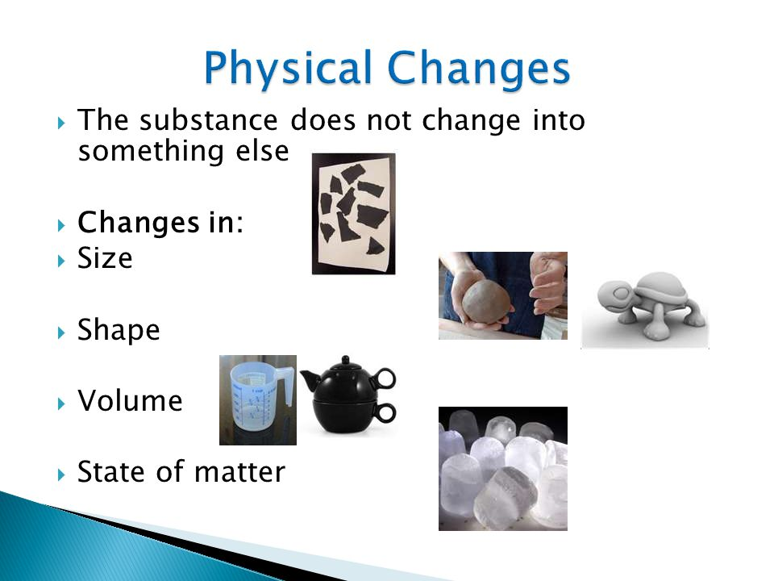
Physical changes of state
Matter has different properties, like shape, size and state.

Slide 6

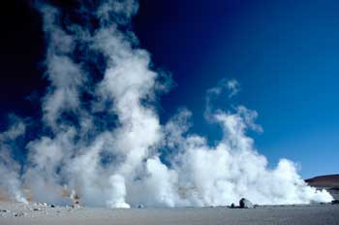
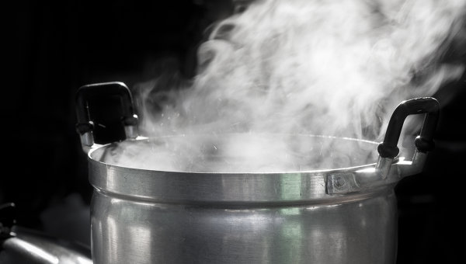
GASES
They don’t have a definite shape.
They change to the shape of the containers they are in.
They don’t have a definite volume.
They fill the container they are in.

Slide 7
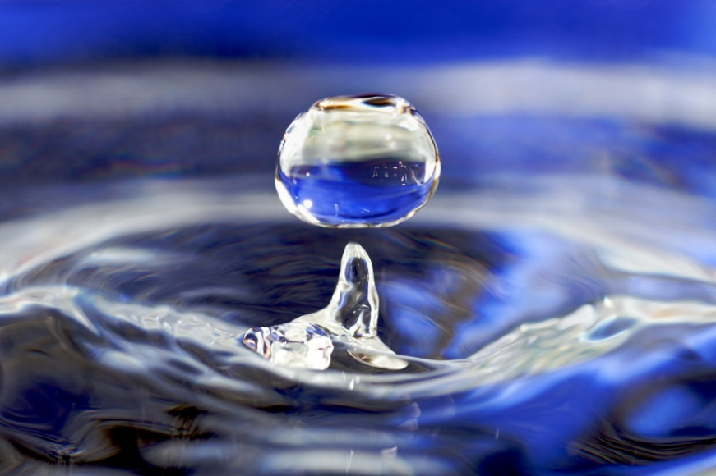
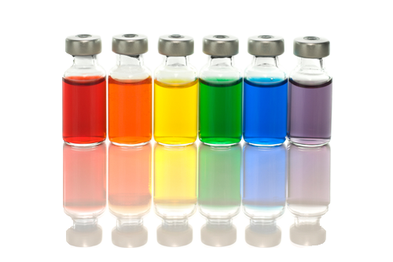
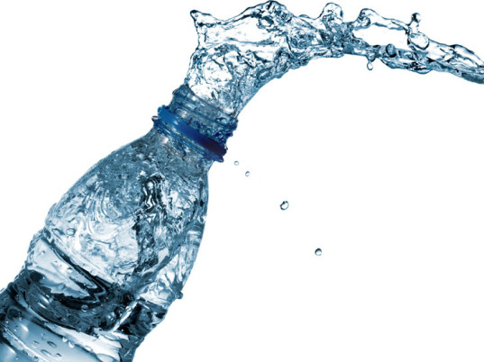
LIQUIDS
They don’t have a definite shape.
They take the shape of their container.
They have a definite volume.

Slide 8
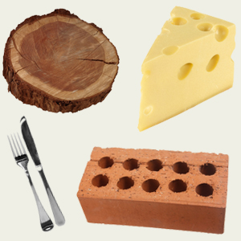
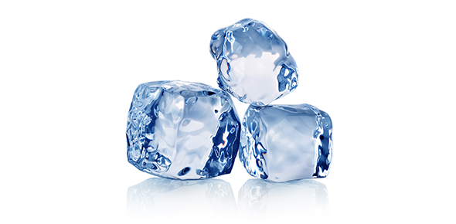
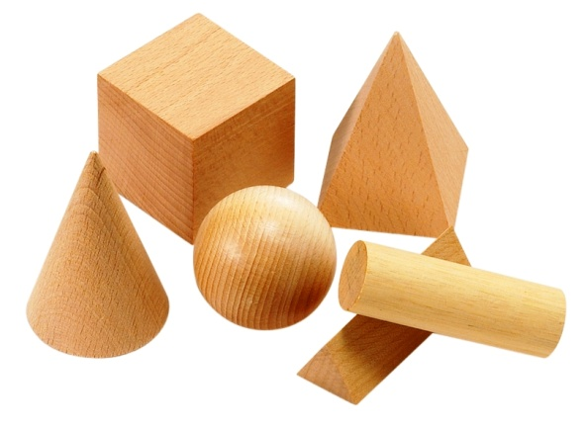
SOLIDS
They have a definite shape.
They have a definite volume.

Slide 9




Shape and volume
 | SOLID | LIQUID | GAS
DEFINITE SHAPE | YES | NO | NO
DEFINITE VOLUME | YES | YES | NO

Slide 10
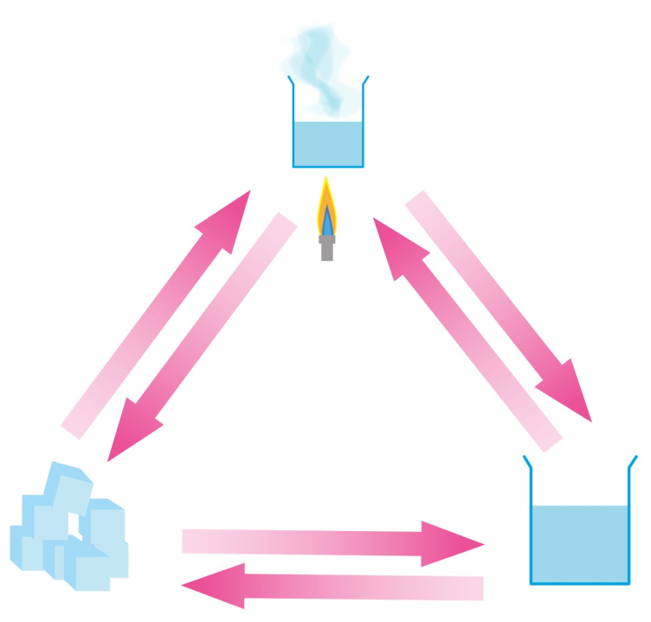
Change of State
Liquid Solid
Solid Liquid
Liquid Gas
Gas Liquid

Slide 11
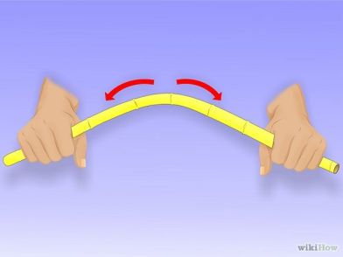

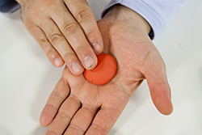

Changes of shape
BEND
TWIST
PRESS
STRECHT

Slide 12
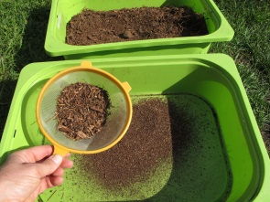
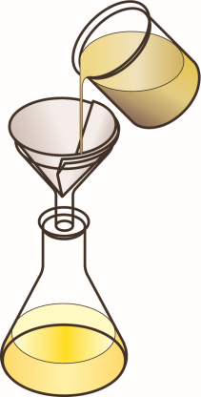
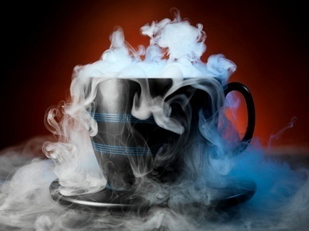
Separating materials in a mixture
We can separate materials in a mixture by sieving, filtering or evaporating.
Sieving: good for separating solids of different sizes.
Filtering: good for separating solids and liquids
Evaporating: good for separating a solid that is dissolved in a liquid.

